Slide 1

SARASWATI COLLEGE OF ENGINERRING KHARGHAR
DEPARTMENT OF (E&TC)
PRESENTATION ON
SMART CART
PRESENTED BY
BHAVIKA KADU –( 08)
KAMLESH JOHRE –(05)
ROHIT BARANWAL – (01)
SHARAYU PATIL – (15)
GUIDED BY
PROF. NEHA MAHAJAN

Slide 2
CONTENT
1. | INTRODUCTION
2. | OBJECTIVE
3. | LITERATURE SURVEY
4. | PROPOSED SYSTEM
5. | BLOCK DIAGRAM
6. | WORKING
7. | ADVANTAGES
8. | RESULTS AND CONCLUSION

Slide 3
INTRODUCTION
The modern technology has increased the standard of living for the humans. This resulted in large crowds at shopping malls. To handle the large crowd, we must reduce the time taken for the billing process.
This is done using smart shopping cart. Items that are put in a smart shopping cart are read one by one and the bill is generated and displayed.
After the final bill is generated the customer pays the bill by usual paying methods (by cash , credit/debit cards , online transactions). With this system, there is no need for customer to wait in the queue for the scanning for the product items for billing purpose.
The aim of our project “SMART SHOPPING CART” is to reduce time consumption during the billing process and longtime standing crowd near the bill counters.
Supermarkets and hypermarkets use this technique as a strategy to increase the number of customers.

Slide 4
OBJECTIVES
The main objective of this project is to reduce and eliminate time taken in billing counter in super markets by designing an intelligent Shopping Cart which uses Barcode scanners to allow users to self-checkout and increase productivity time.
The smart shopping cart would consist of the Raspberry Pi, barcode Reader, weighing scale and an Screen Display.

Slide 5
[1] Gubbi, J., Bunya, R., Marsico, S., Palani swami, S.: Internet of Things (IoT): a vision architectural elements, and future directions. IEEE (2011).
Instead of using the bar code tags this system used two barcode scanners to scan the products and automatically bill them in the LCD display connected with the raspberry Pi. The proposed system solves the problem of using bar-code tags which cannot be used with cheaper products. The display is just used to bill the products together and it does not provide any additional information about the products. Also using two barcode scanners instead of one is not very efficient and it draws more power and increase the cost of system with no additional benefits. The proposed system solves the problem of long queues very well using this approach however it failed to give any security features to the system. It’ll be very hectic for the admin to manually check each and every product with the bill generated by the system.
LITERATURE SURVEY

Slide 6
Dubey, V., Sangeetha Sagar, V.R.. Somalia, S. Abhilash, C.B.: An Android approach for wireless power harvesting from radio waves. In: Contemporary Computing and Informatics (IC31), pp. 1235-1239 IEEE (2014) .
This trolley system uses RFID tags on products that one wants to buy, which are read by barcode scanner and the cost of that product is displays on the LCD screen attached to that system. As customer buy the next product its price is added with the previous amount. The cost of the product is given to the microcontroller by using Zigbee communication from the host PC. Zigbee supports a bidirectional communication between microcontroller and host PC. Customer get direct bill at the billing section which is already stored at host PC which ultimately reduces queue. AS in this it uses Zigbee communication it has disadvantage like low transmission as well as low network stability and also Zigbee is not secure like Wi-Fi based security system.

Slide 7
Proposed System
Our proposed smart shopping system should achieve the following major goals:
Item reading: The smart cart should be able to accurately read items put into or removed from the cart and is linked with the Supermarket's backend database which contains features of the products such as Cost Price.
Items tracking: The server should maintain the state of items in the store. With Bar-code Scanner installed, the items can be monitored and the item stock can be updated to the server.

Slide 8
Block Diagram
Barcode Scanner
Raspberry Pi
Weighing scale
Thermal Printer
Data Base
Screen Display

Slide 9
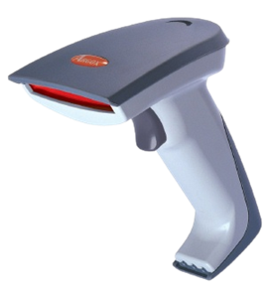
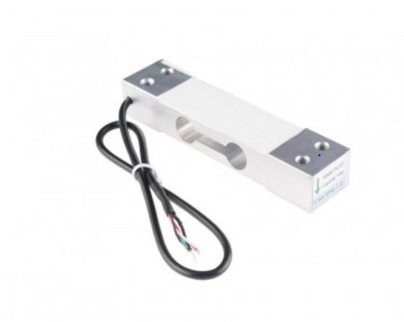
components
Barcode scanner:
A barcode reader is an optical scanner that can read printed barcodes, decode the data contained in the barcode to a computer.
Weighing scale:
Weighing scale will help us in authentication process at check out counter.

Slide 10
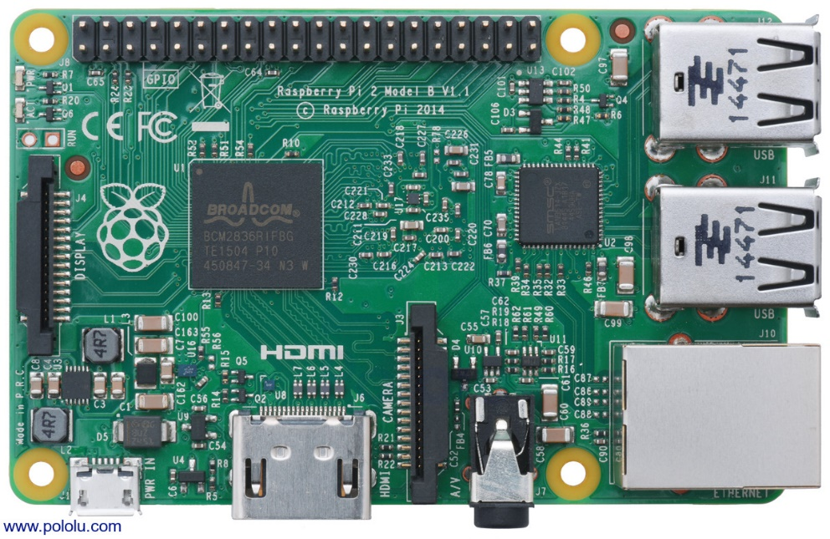
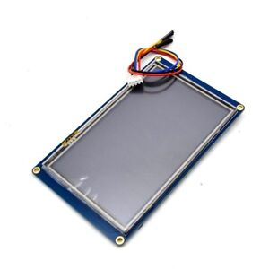
Components
Raspberry Pi 2 model B:
The Raspberry Pi is a credit card-sized computer. The Raspberry Pi 2 Model B is the second generation Raspberry Pi.
3.5″ Touch Screen LCD Raspberry Pi Display:
This small 3.5 inch touch screen Raspberry Pi Display module is designed especially for Raspberry Pi, using the latest Linux Core system.

Slide 11
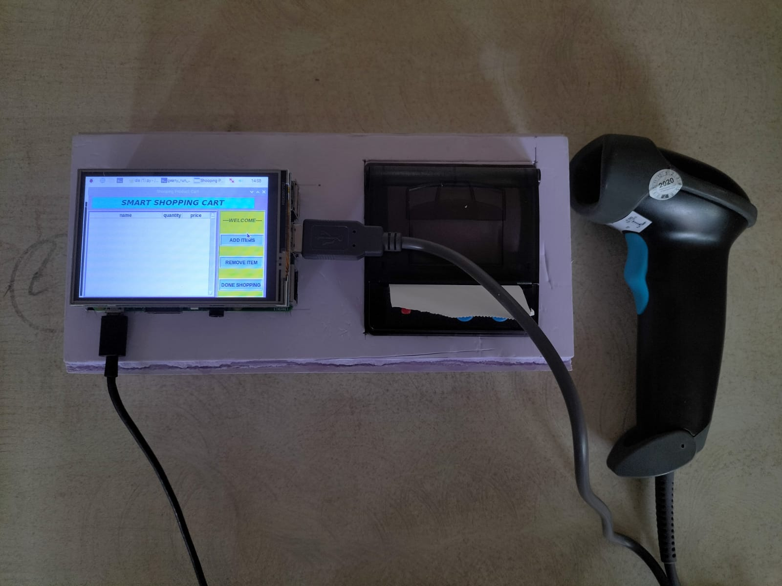
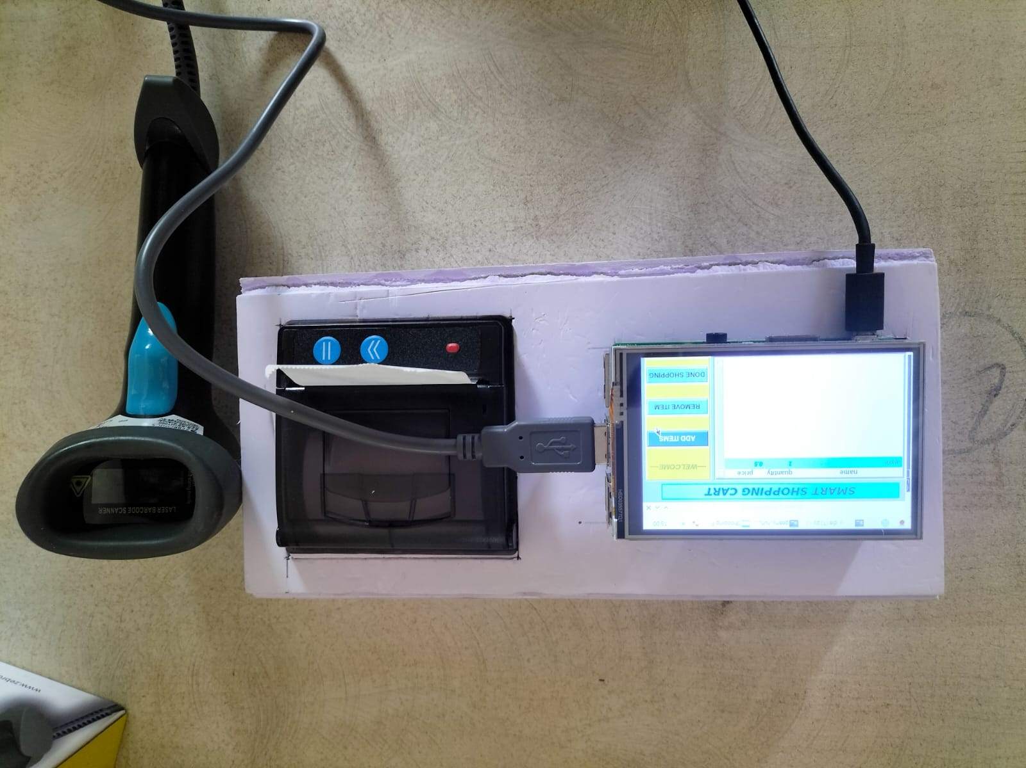
RESULTS
Fig (1): SMART CART WITH ADDING ANY ITEMS IN THE CART
Fig (2): SMART CART ADDING ITEMS IN THE CART

Slide 12
WORKING
The customer enters the store and once take the cart ,he/she can proceed for purchasing the product without doing any registration .
The customer has to himself scan the product’s barcode by the given barcode scanner and has to place the product into the cart after scanning. At this moment the Arduino will register the product on the web page and weigh the product at the same time.
As the customer keeps on scanning and adding the products to the cart the Arduino will keep on adding the products to the web page and the weighing scale will weigh the products and Arduino will keep a track on it.
If the customer wants to remove the product ,the customer has to click on remove button and scan the barcode of the product he/she want to remove and he/she has to remove the product from the cart as well .

Slide 13
Once the customer has completed shopping and has to pay the bill , he/she has to has to select ‘Checkout’ button . once checkout button is selected he/she will have two options available for making the payment, one is QR Code and the second option is Cash payment.
If the customer makes the payment by scanning the Qr code the bill will be printed from the thermal printer machine only once the payment is successful. if the customer has to make the payment via cash, the customer has to visit the cashier.
As the customer clicks on checkout button the Arduino will compare the weight of registered product from web page and the weight from weighing scale, if there is a mismatch in weight more than 5 grams, the bill will not be printed and the customer cannot checkout.
Once the payment is done and customer wants to exit the store, the customer has to go through a security check and the security person will check the total weight printed on the bill and the total weight of the cart.

Slide 14
Users will be able to Read the bar-code themselves. Display the total amount before payment. Ability to set the shopping Budget. Ability to remove unwanted product.
KEY FEATURES:
Key features of POS system:
Inventory management.
Billing Management.
Report management

Slide 15
Advantages
This system helps in achieving a faster billing system.
The innovation payment method avoid the long waiting time.
Helps the buyer to know the bill details in advance so that he can plan an affordable purchase.
Intimate the customers about the current offers by showing pop-up the trolley screen. Helps in business promotions for the supermarkets by gaining more customers providing quick service.
Easy to use and does not need any special training.

Slide 16
LIMITATIONS
Large scale implementation can be difficult.
Privacy concerns.
Installations complications.
Acceptance of new technology.
Maintenance cost.
Extra care and consideration is required.
Security issues.

Slide 17
FUTURE ENHANCEMENT
In Smart Trolley System, now there is no need for the customers to wait in the queue and wait for his/her turn for the scanning of the product items. Especially during weekends or festivals season, there is not time wastage in waiting in the queue.
In future this intelligence system will advice the customer which products can be removed from the basket if the budget exceeds.
Also, with the help of optical sensor, motors, and motor drivers will make trolley in such a way that it will follow the customer which purchasing items.

Slide 18
In conclusion, a smart shopping cart that utilizes a barcode scanner to recognize products and verify weights for authentication is an efficient and convenient way to enhance the shopping experience. By using a Raspberry Pi and a HX711 weight sensor with a barcode scanner, the system can quickly and accurately identify products and ensure that the correct weight is being registered. This system can help prevent errors in pricing and weight measurements, ultimately leading to a better shopping experience for customers. Additionally, by displaying the total amount of the products in real-time on a user-friendly interface, users can keep track of their purchases and ensure that they stay within their budget. Overall, this smart shopping cart system offers an efficient, accurate, and user-friendly approach to grocery shopping.
CONCLUSION

Slide 19
REFERENCES
Gubbi, J., Bunya, R., Marsico, S., Palani swami, S.: Internet of Things (IoT): a vision architectural elements, and future directions. IEEE (2011). https://doi.org/10.1109/ smac2017.8058399.
Dubey, V., Sangeeth Sagar, V.R.. Sumalya, S. Abhilash, C.B.: An Android approach for wireless power harvesting from radio waves. In: Contemporary Computing and Informatics (IC31), pp. 1235-1239 IEEE (2014) https://doi.org/10.1109/c3i 2014.7019670 .
Gangwal. U., Roy, S. Bapat, J. Smart shopping cart for automated billing purpose using wireless sensor networks. IEEE (2013). https://doi.org/10.1109/icices.2014.703399.
Yathishu, L., Abhishek, A., Harshith, R., Darshan Koundinya, S.R., Srinidhi, K.: Automation of shopping cart to ease queue in malls by using RFID (2015). https://doi.org/10.1109/cices

